Slide 1
Breakfast of Champions
By Allie Wicklund

Slide 2
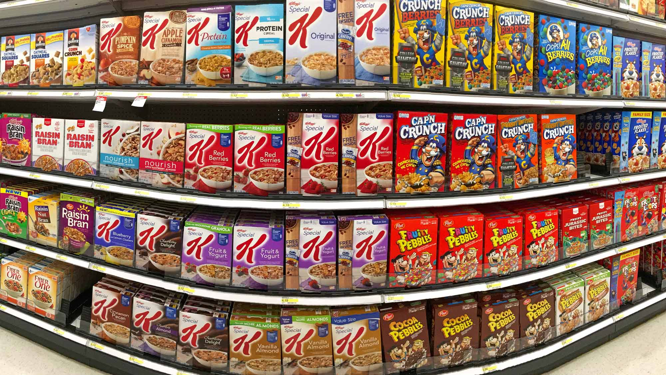

Slide 3
My ideal cereal
Filling
Sweet
Low calorie

Slide 4

My ideal cereal
Filling
Sweet
Low calorie…?

Slide 5
Ingredients List
Bran/Wheat Debate
Sugar and Calories
Crowd Favorites

Slide 6
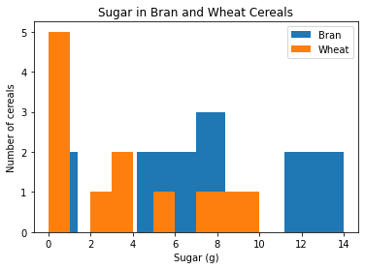

Slide 7
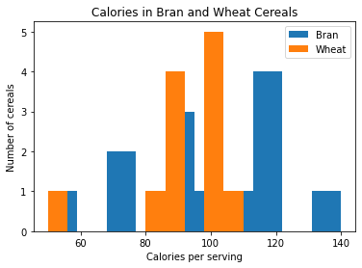

Slide 8
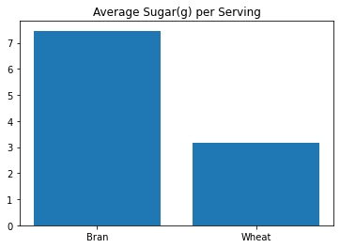
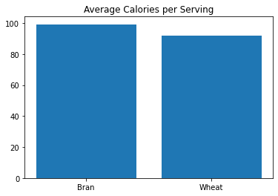

Slide 9
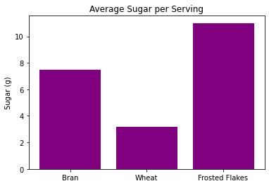
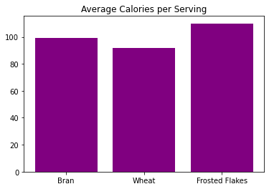

Slide 10
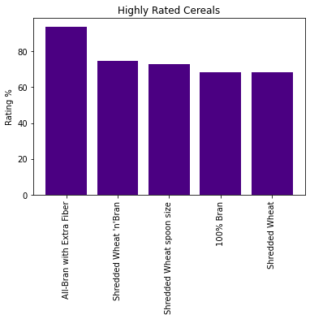

Slide 12
Serving Size? Calories per cup!
Calories in a serving size
Number of cups in the serving size

Slide 13
Serving Size? Calories per cup!*
Calories in a serving size
Number of cups in the serving size
*the next slide isn’t for the faint of heart

Slide 14
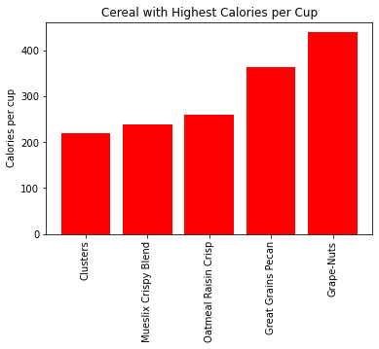

Slide 15
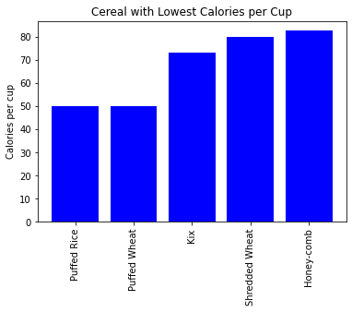

Slide 16
Take-aways

Slide 17
Take-aways
Kix meets all 3 criteria

Slide 18
Take-aways
Kix meets all 3 criteria
Bran flakes can be high in sugar

Slide 19
Take-aways
Kix meets all 3 criteria
Bran flakes can be high in sugar
Not all presentations need complex displays

